Slide 1
Feature Selection and Extraction

Slide 2
Curse of dimensionality

Slide 3
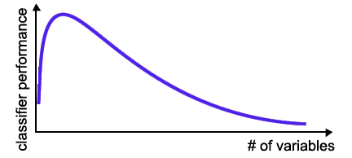
Curse of dimensionality
The required number of samples (to achieve the same accuracy) grows exponentionally with the number of variables (or features)!
In practice: number of training examples is fixed!
=> the classifier’s performance usually degrade for a large number of features!
In many cases the information that is lost by discarding variables is made up for by a more accurate mapping/sampling in the lower-dimensional space !

Slide 5
What is Feature selection ?
Feature selection: Problem of selecting some subset of a learning algorithm’s input variables upon which it should focus attention, while ignoring the rest (DIMENSIONALITY REDUCTION)
Humans/animals do that constantly!

Slide 6
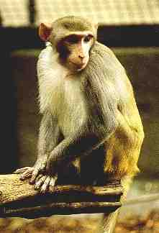
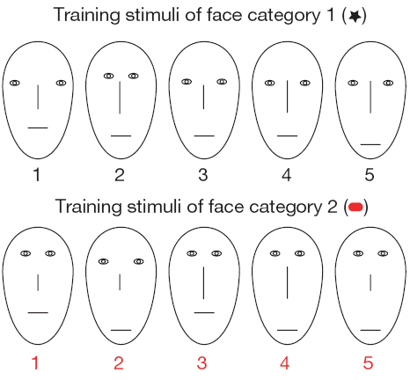
Motivational example from Biology
Monkeys performing classification task
?

Slide 7
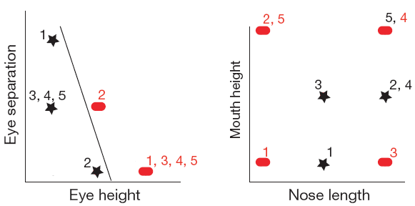
Motivational example from Biology
Monkeys performing classification task
Diagnostic features:
- Eye separation
- Eye height
Non-Diagnostic features:
- Mouth height
- Nose length

Slide 8
Motivational example from Biology
Monkeys performing classification task
Results:
activity of a population of 150 neurons in the anterior inferior temporal cortex was measured
44 neurons responded significantly differently to at least one feature
After Training: 72% (32/44) were selective to one or both of the diagnostic features (and not for the non-diagnostic features)

Slide 9
Feature Selection in ML ?
Why even think about Feature Selection in ML?
The information about the target class is inherent in the variables!
Naive theoretical view: More features => More information => More discrimination power.
In practice: many reasons why this is not the case!
Also: Optimization is (usually) good, so why not try to optimize the input-coding ?

Slide 10
Feature Selection
Y
X
Remove features X_{i} to improve (or least degrade) prediction of Y.
Notes:
Prediction performance is assessed with a given risk functional, not depicted.

Slide 11
Feature Selection in ML ? YES!
Many explored domains have hundreds to tens of thousands of variables/features with many irrelevant and redundant ones!
- In domains with many features the underlying probability distribution can be very complex and very hard to estimate (e.g. dependencies between variables) !
Irrelevant and redundant features can „confuse“ learners!
Limited training data!
Limited computational resources!
Curse of dimensionality!

Slide 12
Uncovering Dependencies
?
Factors of variability
Actual
Artifactual
Known
Unknown
Observable
Unobservable
Controllable
Uncontrollable
Notes:
Classical statistics is mostly preoccupied by finding significant dependencies.
Don’t confuse dependency/correlation and causality.

Slide 13
Example for ML-Problem
Gene selection from microarray data
Variables: gene expression coefficients corresponding to the amount of mRNA in a patient‘s sample (e.g. tissue biopsy)
Task: Seperate healthy patients from cancer patients
Usually there are only about 100 examples (patients) available for training and testing (!!!)
Number of variables in the raw data: 6.000 – 60.000
Does this work ?

Slide 14
Example for ML-Problem
Text-Categorization
Documents are represented by a vector of dimension the size of the vocabulary containing word frequency counts
Vocabulary ~ 15.000 words (i.e. each document is represented by a 15.000-dimensional vector)
Typical tasks:
Automatic ranking of documents into web-directories
Detection of spam-email
Especially when dealing with a large number of variables there is a need for dimensionality reduction!
Feature Selection can significantly improve a learning algorithm’s performance!

Slide 15
PROBLEM
Data sets may be of the WIDE type: small number of objects, large number of features
FEATURES
(attributes, variables, covariates...)
1 2 3 . . . n
1
2
3
.
N
OBJECTS
8
object # 3
feature # 2

Slide 16
Feature selection
Feature subsets
2 questions
How do we select the subsets?
How do we evaluate the worth of a subset?
Not our problem now
Wrapper
Filter
Embedded
Classification accuracy
Some easier-to-calculate proxy for the
Classification accuracy
Decision tree classifier
SVM

Slide 17
Feature selection
Feature subsets
2 questions
How do we select the subsets?
How do we evaluate the worth of a subset?
Wrapper
Filter
Embedded


Bespoke
Ranker
Heuristic search

Swarm optimisation
Greedy
Sequential Forward Selection (SFS)
Genetic Algorithms (GA)
Random

Slide 18
Feature Selection Method
Feature selection methods are grouped into three classes :
Those that embed the selection into induction algorithm
Those that use feature selection algorithm to filter the attributes passed to induction algorithm
Those that treat feature selection as a wrapper around the induction process

Slide 19
Feature selection strategies
Filter approach
Wrapper approach
Embedded approach
Classification Model
FS
FS
Search Method
Classification Model
Classification Model
Classification Model
Parameters FS
Feature selection based on signal processing techniques

Slide 20
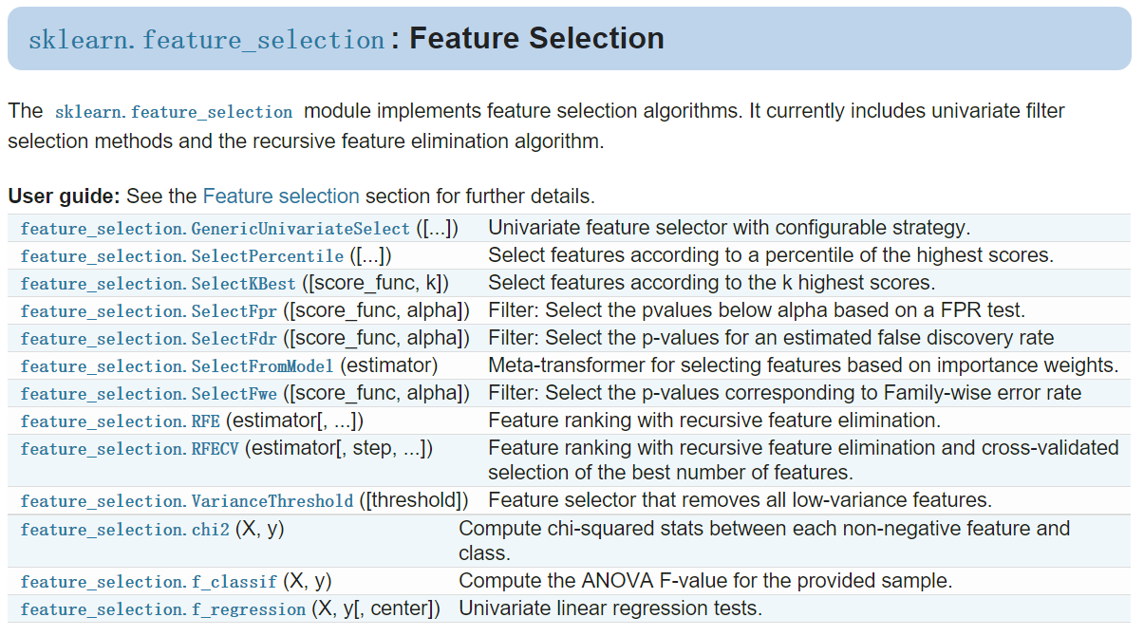

Slide 21

Filter Approaches
Feature selection is done based on some general characteristics of the training set.
Independent of the induction algorithm used, and thus, can be combined with any such method.

Slide 22
A Simple Filtering Scheme
Evaluate each feature individually based on its correlation with the target function.
Select the ‘k’ features with the highest value.
The best choice of ‘k’ can be determined by testing on a holdout set.

Slide 23
Filter methods
chi2: Compute the test chi-squared statistic, and can be used to select the highest values from X, which must contain only non-negative features such as booleans or frequencies relative to the classes.
ANOVA F-value: Compute the ANOVA F-value for the provided sample, useful for numerical variables.
f_regression: Univariate linear regression tests, a model for testing the effect of a single regressor, sequentially for many regressors.

Slide 24
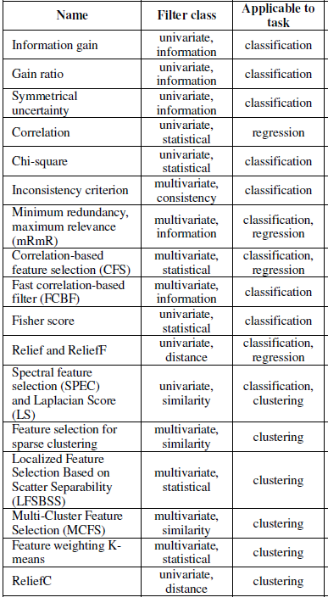
Filters
Select features based on a performance measure regardless of the employed data modeling algorithm
Many performance measures described in literature
Fast, but not as accurate as wrappers

Slide 25
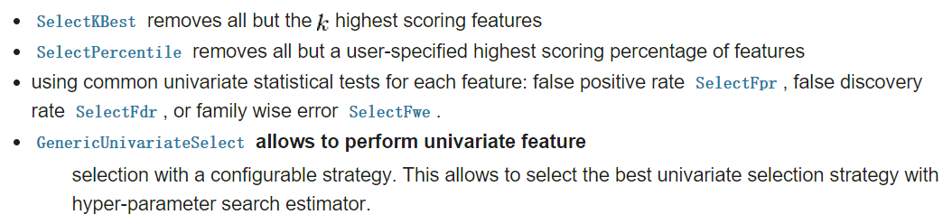
Selection schemes

Slide 26



Filter methods
ANOVA F-value: suitable for numeric type variables
between-group variability
within-group variability

Slide 27
SVM-Anova
import numpy as np
import matplotlib.pyplot as plt
from sklearn import svm, datasets, feature_selection, cross_validation
from sklearn.pipeline import Pipeline
# Import some data to play with
digits = datasets.load_digits()
y = digits.target
# Throw away data, to be in the curse of dimension settings
y = y[:200]
X = digits.data[:200]
n_samples = len(y)
X = X.reshape((n_samples, -1))
# add 200 non-informative features
X = np.hstack((X, 2 * np.random.random((n_samples, 200))))

Slide 28
# Create a feature-selection transform and an instance of SVM
transform = feature_selection.SelectPercentile(feature_selection.f_classif)
clf = Pipeline([('anova', transform), ('svc', svm.SVC(C=1.0))])
# Plot the cross-validation score as a function of percentile of features
score_means = list()
score_stds = list()
percentiles = (1, 3, 6, 10, 15, 20, 30, 40, 60, 80, 100)
for percentile in percentiles:
clf.set_params(anova__percentile=percentile)
# Compute cross-validation score using all CPUs
this_scores = cross_validation.cross_val_score(clf, X, y, n_jobs=1)
score_means.append(this_scores.mean())
score_stds.append(this_scores.std())
plt.errorbar(percentiles, score_means, np.array(score_stds))

Slide 29
Univariate selection may fail
Guyon-Elisseeff, JMLR 2004; Springer 2006
Notes:
Constantin’s comments: consider title “sometimes univariate selection fails”

Slide 30
Heuristic Search is an ideal paradigm for Feature selection algorithms.
Feature Selection as Heuristic Search

Slide 31
Feature Selection as Heuristic Search
Search Space Partial Order

Slide 32
Four Basic Issues
Where to start?
Forward Selection
Bckward Elimination

Slide 33
Four Basic Issues
How to organize the search?
Exhaustive search: 2^{n} possibilities for n attributes
Greedy search:
Hill climbing
First is best

Slide 34
Four Basic Issues
Which is better? - Strategy to evaluate alternatives
Accuracy on training or separate evaluation set
Feature selection-basic induction interaction

Slide 35
Four Basic Issues
When to stop?
Stop when nothing improves
Go on until things worsen
Reach the end and select best
Each combination of selected features map to single class
Order by relevance and determine a break point

Slide 36
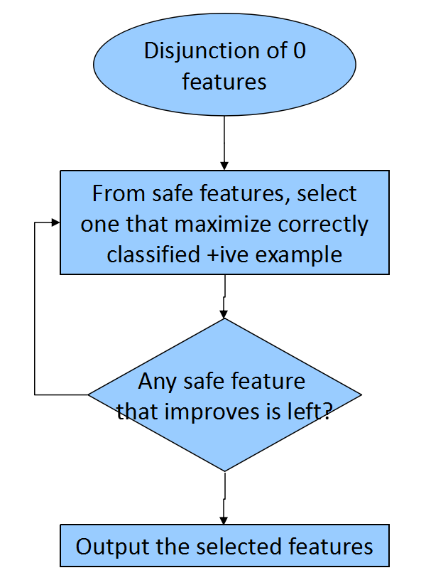
An Example – Set Cover Algorithm
`
Begins at the left of the figure
Incrementally move right
Evaluate based on performance on training set with penalty for misclassifying -
Halts when no further step improves performance
Y
N

Slide 37
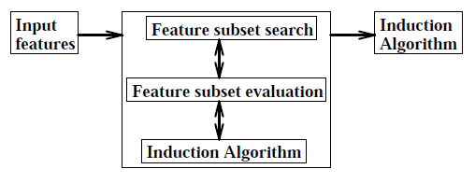
Wrapper Approaches
Motivation: The features selected should depend not only on the relevance of the data, but also on the learning algorithm.

Slide 38
Wrapper Approaches
Advantage: The inductive method that uses the feature subset provides a better estimate of accuracy than a separate measure that may have an entirely different inductive bias.
Disadvantage: Computational cost, which results from calling the induction algorithm for each feature set considered.
Modifications:
Caching decision trees
Reducing percentage of training cases

Slide 39
Wrapper methods
SVM. This classifier builds a linear function that separates the classes. The hyperplane is calculated so as to maximise the distance to the nearest points. The absolute values of the coefficients in front of the features can be interpreted as “importance”.
SVM-RFE. RFE stands for “Recursive Feature Elimination” (Guyon et al., 2006). Starting with an SVM on the entire feature set, a fraction of the features with the lowest weights is dropped. A new SVM is trained with the remaining features, and subsequently reduced in the same way. The procedure stops when the set of the desired cardinality is reached. While SVM-RFE has been found to be extremely useful for wide data such as functional magnetic resonance imaging (fMRI) data it was discovered that the RFE step is not always needed.

Slide 40
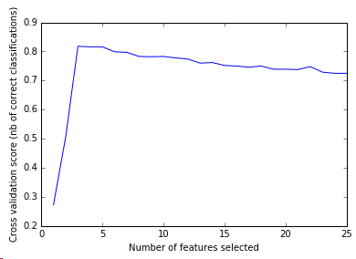
Recursive feature elimination with cross-validation
import matplotlib.pyplot as plt
from sklearn.svm import SVC
from sklearn.cross_validation import StratifiedKFold
from sklearn.feature_selection import RFECV
from sklearn.datasets import make_classification
# Build a classification task using 3 informative features
X, y = make_classification(n_samples=1000, n_features=25, n_informative=3, n_redundant=2, n_repeated=0, n_classes=8, n_clusters_per_class=1,
random_state=0)
## make_classification Generate a random n-class classification problem.
# Create the RFE object and compute a cross-validated score.
svc = SVC(kernel="linear")
# The "accuracy" scoring is proportional to the number of correct classifications
rfecv = RFECV(estimator=svc, step=1, cv=StratifiedKFold(y, 2),
scoring='accuracy')
rfecv.fit(X, y)

Slide 41
Wrappers
Consider feature subsets by the quality of performance of a modeling algorithm, which is taken as a black box evaluator.
The evaluation is repeated for each feature subset
Very slow, highly accurate
Dependent on the modeling algorithm, may introduce bias

Slide 42
Embedded Approaches in Binary Feature Space
Gives attractive results for systems learning pure conjunctive (or pure disjunctive) rules.
At most logarithmic factor more than smallest possible hypothesis!
Also applies in settings where target hypothesis is characterized by conjunction (or disjunction) of functions produced by induction algorithms

Slide 43
Embedded Approaches for Complex Logical Concepts
In this approach, the core method adds/removes features to induce complex logical concepts.
e.g. ID3 and C4.5
Greedy search through space of decision tree
Each stage select attribute that discriminate among classes using evaluation function (usually based on information theory)

Slide 44
Example of Decision Tree Induction
Initial attribute set:
{A1, A2, A3, A4, A5, A6}
A4 ?
A1?
A6?
Class 1
Class 2
Class 1
Class 2
>
Reduced attribute set: {A1, A4, A6}

Slide 45
Embedded Approaches: Scalability Issues
Experimental studies suggest decision list learners scale linearly with increase in irrelevant features
For other target concepts, exhibit exponential growth.
(Kira and Rendell, 1992) shows that there is substantial decrease in accuracy on inserting irrelevant features into Boolean target concept.

Slide 46
Embedded Approaches: Remedies
Problems are caused due to reliance on greedy selection of attributes to discriminate among classes.
Some researchers attempted to replace greedy approach with look-ahead techniques.
Letting Greedy take larger steps.
None has been able to handle scaling effectively.

Slide 47
Hybrid methods
Combine the best properties of filters and wrappers.
Usual approach:
First, a filter method is used in order to reduce the feature space dimension space, possibly obtaining several candidate subsets.
Then, a wrapper is employed to find the best candidate subset.
Highly used in recent years
E.g. fuzzy random forest feature selection, hybrid genetic algorithms, mixed gravitational search algorithm...

Slide 48
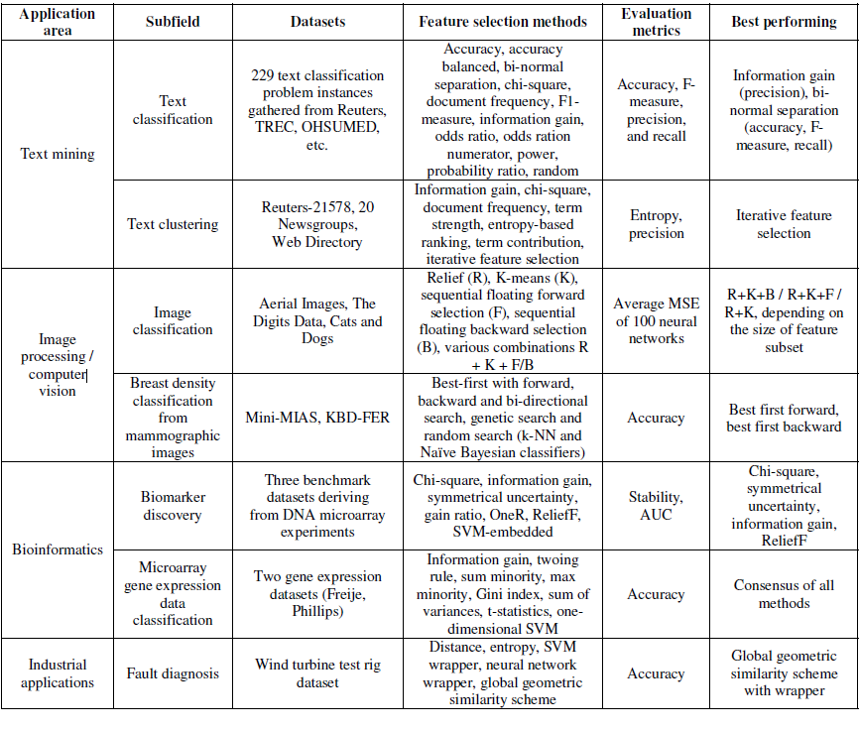
Application domains

Slide 49
Feature Selection / Extraction
Feature Selection:
Feature Extraction/Creation
F
F‘
F
F‘

Slide 50
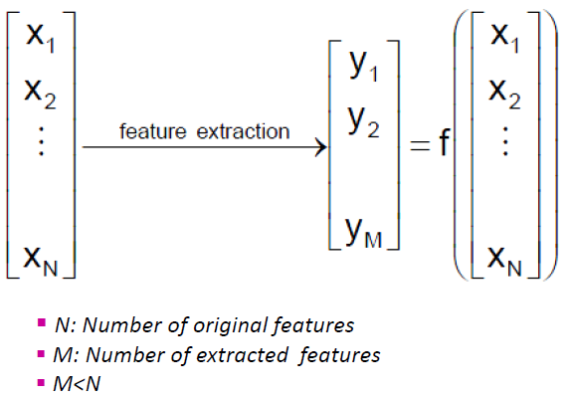
Feature extraction
Feature Extraction: Create new feature based on transformations or combinations of the original feature set.

Slide 51
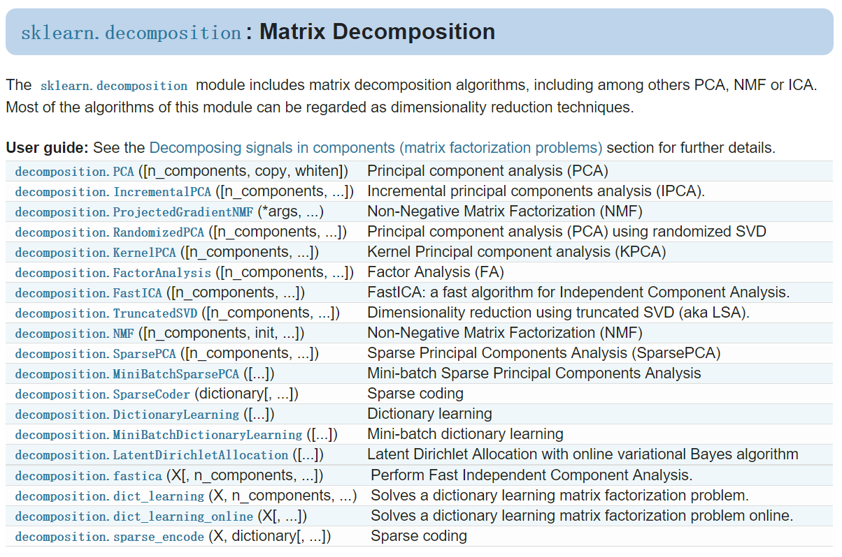
Referred as Feature Extraction usually

Slide 52
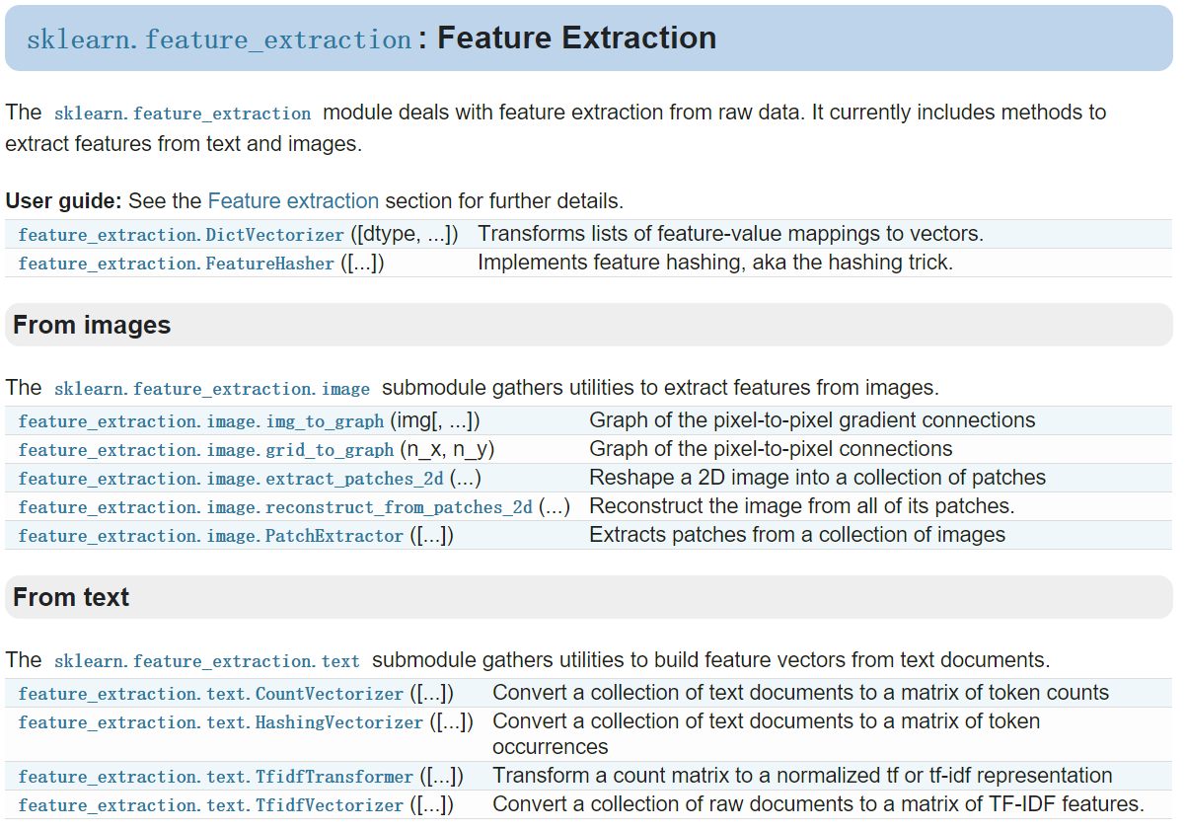

Slide 53
Feature extraction
Linear transformation
PCA. The absolute values of the coefficients in front of the features can be interpreted as “importance”. a statistical procedure that uses an orthogonal transformation to convert a set of observations of possibly correlated variables into a set of values of linearly uncorrelated variables called principal components. ----Unsupervised method
LDA. Used to find a linear combination of features that characterizes or separates two or more classes of objects or events.
----Supervised method
Non-Linear transformation
Kernel PCA. LocallyLinearEmbedding. ISOMap. ----Unsupervised method

Slide 54
x₂
x₁

Slide 55
x₂
Make data
to have zero
mean (i.e.
move data into
[0, 0] point).
centering
x₁

Slide 57
x₂
This is a line given by equation
w₀ + w₁x₁ + w₂x₂
This is another line
w’₀ + w’₁x₁ + w’₂x₂
x₁

Slide 58
The variability in data is highest along this line. It is called 1st principal component.
x₂
And this is 2nd principal component.
x₁

Slide 59
x₂
Principal components (PC’s) are linear combinations of original coordinates.
The coefficients of linear combination (w₀, w₁, …) are called loadings.
In the transformed coordinate system, individual data points have different coordinates, these are called scores.
w₀ + w₁x₁ + w₂x₂
w’₀ + w’₁x₁ + w’₂x₂
x₁

Slide 60
PCA - orthogonal linear transformation that changes the data into a new coordinate system such that the variance is put in order from the greatest to the least.
Solve the problem = find new orthogonal coordinate system = find loadings
PC’s (vectors) and their corresponding variances (scalars) are found by eigenvalue decompositions of the covariance matrix C = XX^{T} of the x_{i} variables.
Eigenvector corresponding to the largest eigenvalue is 1st PC.
The 2nd eigenvector (the 2nd largest eigenvalue) is orthogonal to the 1st one. …
Eigenvalue decomposition is computed using standard algorithms: eigen decomposition of covariance matrix (e.g. QR algorithm), SVD of mean centered data matrix.

Slide 61
Interpretation of PCA
New variables (PCs) have a variance equal to their corresponding eigenvalue
Var(Y_{i})= λ_{i} for all I = 1…p
Small λ_{i} ⬄ small variance ⬄ data changes little in the direction of component Y_{i}
The relative variance explained by each PC is given by l_{i} /Σ l_{i}

Slide 62
How many components?
Enough PCs to have a cumulative variance explained by the PCs that is >50-70%
Kaiser criterion: keep PCs with eigenvalues >1
Scree plot: represents the ability of PCs to explain de variation in data

Slide 63
LDA: generalization of Fisher's linear discriminant, a method used in statistics, pattern recognition and machine learning to find a linear combination of features that characterizes or separates two or more classes of objects or events.
LDA

Slide 64
Comparison of LDA and PCA 2D projection of Iris dataset
import matplotlib.pyplot as plt
from sklearn import datasets
from sklearn.decomposition import PCA
from sklearn.discriminant_analysis import LinearDiscriminantAnalysis
iris = datasets.load_iris()
X = iris.data, y = iris.target
target_names = iris.target_names
pca = PCA(n_components=2)
X_r = pca.fit(X).transform(X)

Slide 65
lda = LinearDiscriminantAnalysis(n_components=2)
X_r2 = lda.fit(X, y).transform(X)
# Percentage of variance explained for each components
print('explained variance ratio (first two components): %s'
% str(pca.explained_variance_ratio_))
plt.figure()
for c, i, target_name in zip("rgb", [0, 1, 2], target_names):
plt.scatter(X_r[y == i, 0], X_r[y == i, 1], c=c, label=target_name)
plt.legend()
plt.title('PCA of IRIS dataset')
plt.figure()
for c, i, target_name in zip("rgb", [0, 1, 2], target_names):
plt.scatter(X_r2[y == i, 0], X_r2[y == i, 1], c=c, label=target_name)
plt.legend()
plt.title('LDA of IRIS dataset')
plt.show()

Slide 66
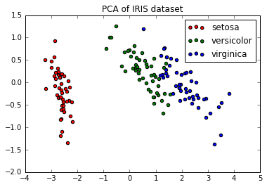
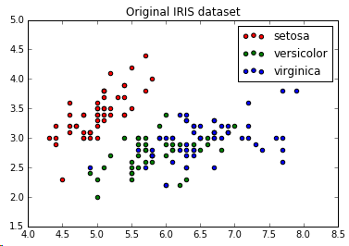
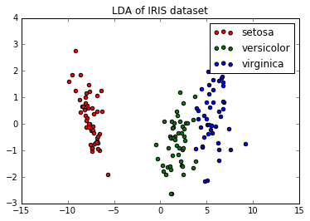
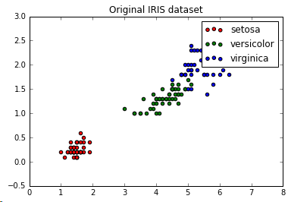

Slide 67
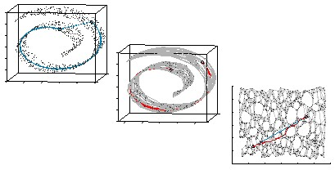
Basic Idea of Manifold

Slide 68
